Slide 1

Real-time Customer 360°
How to build real-time customer analytics and recommendation systems

Slide 2
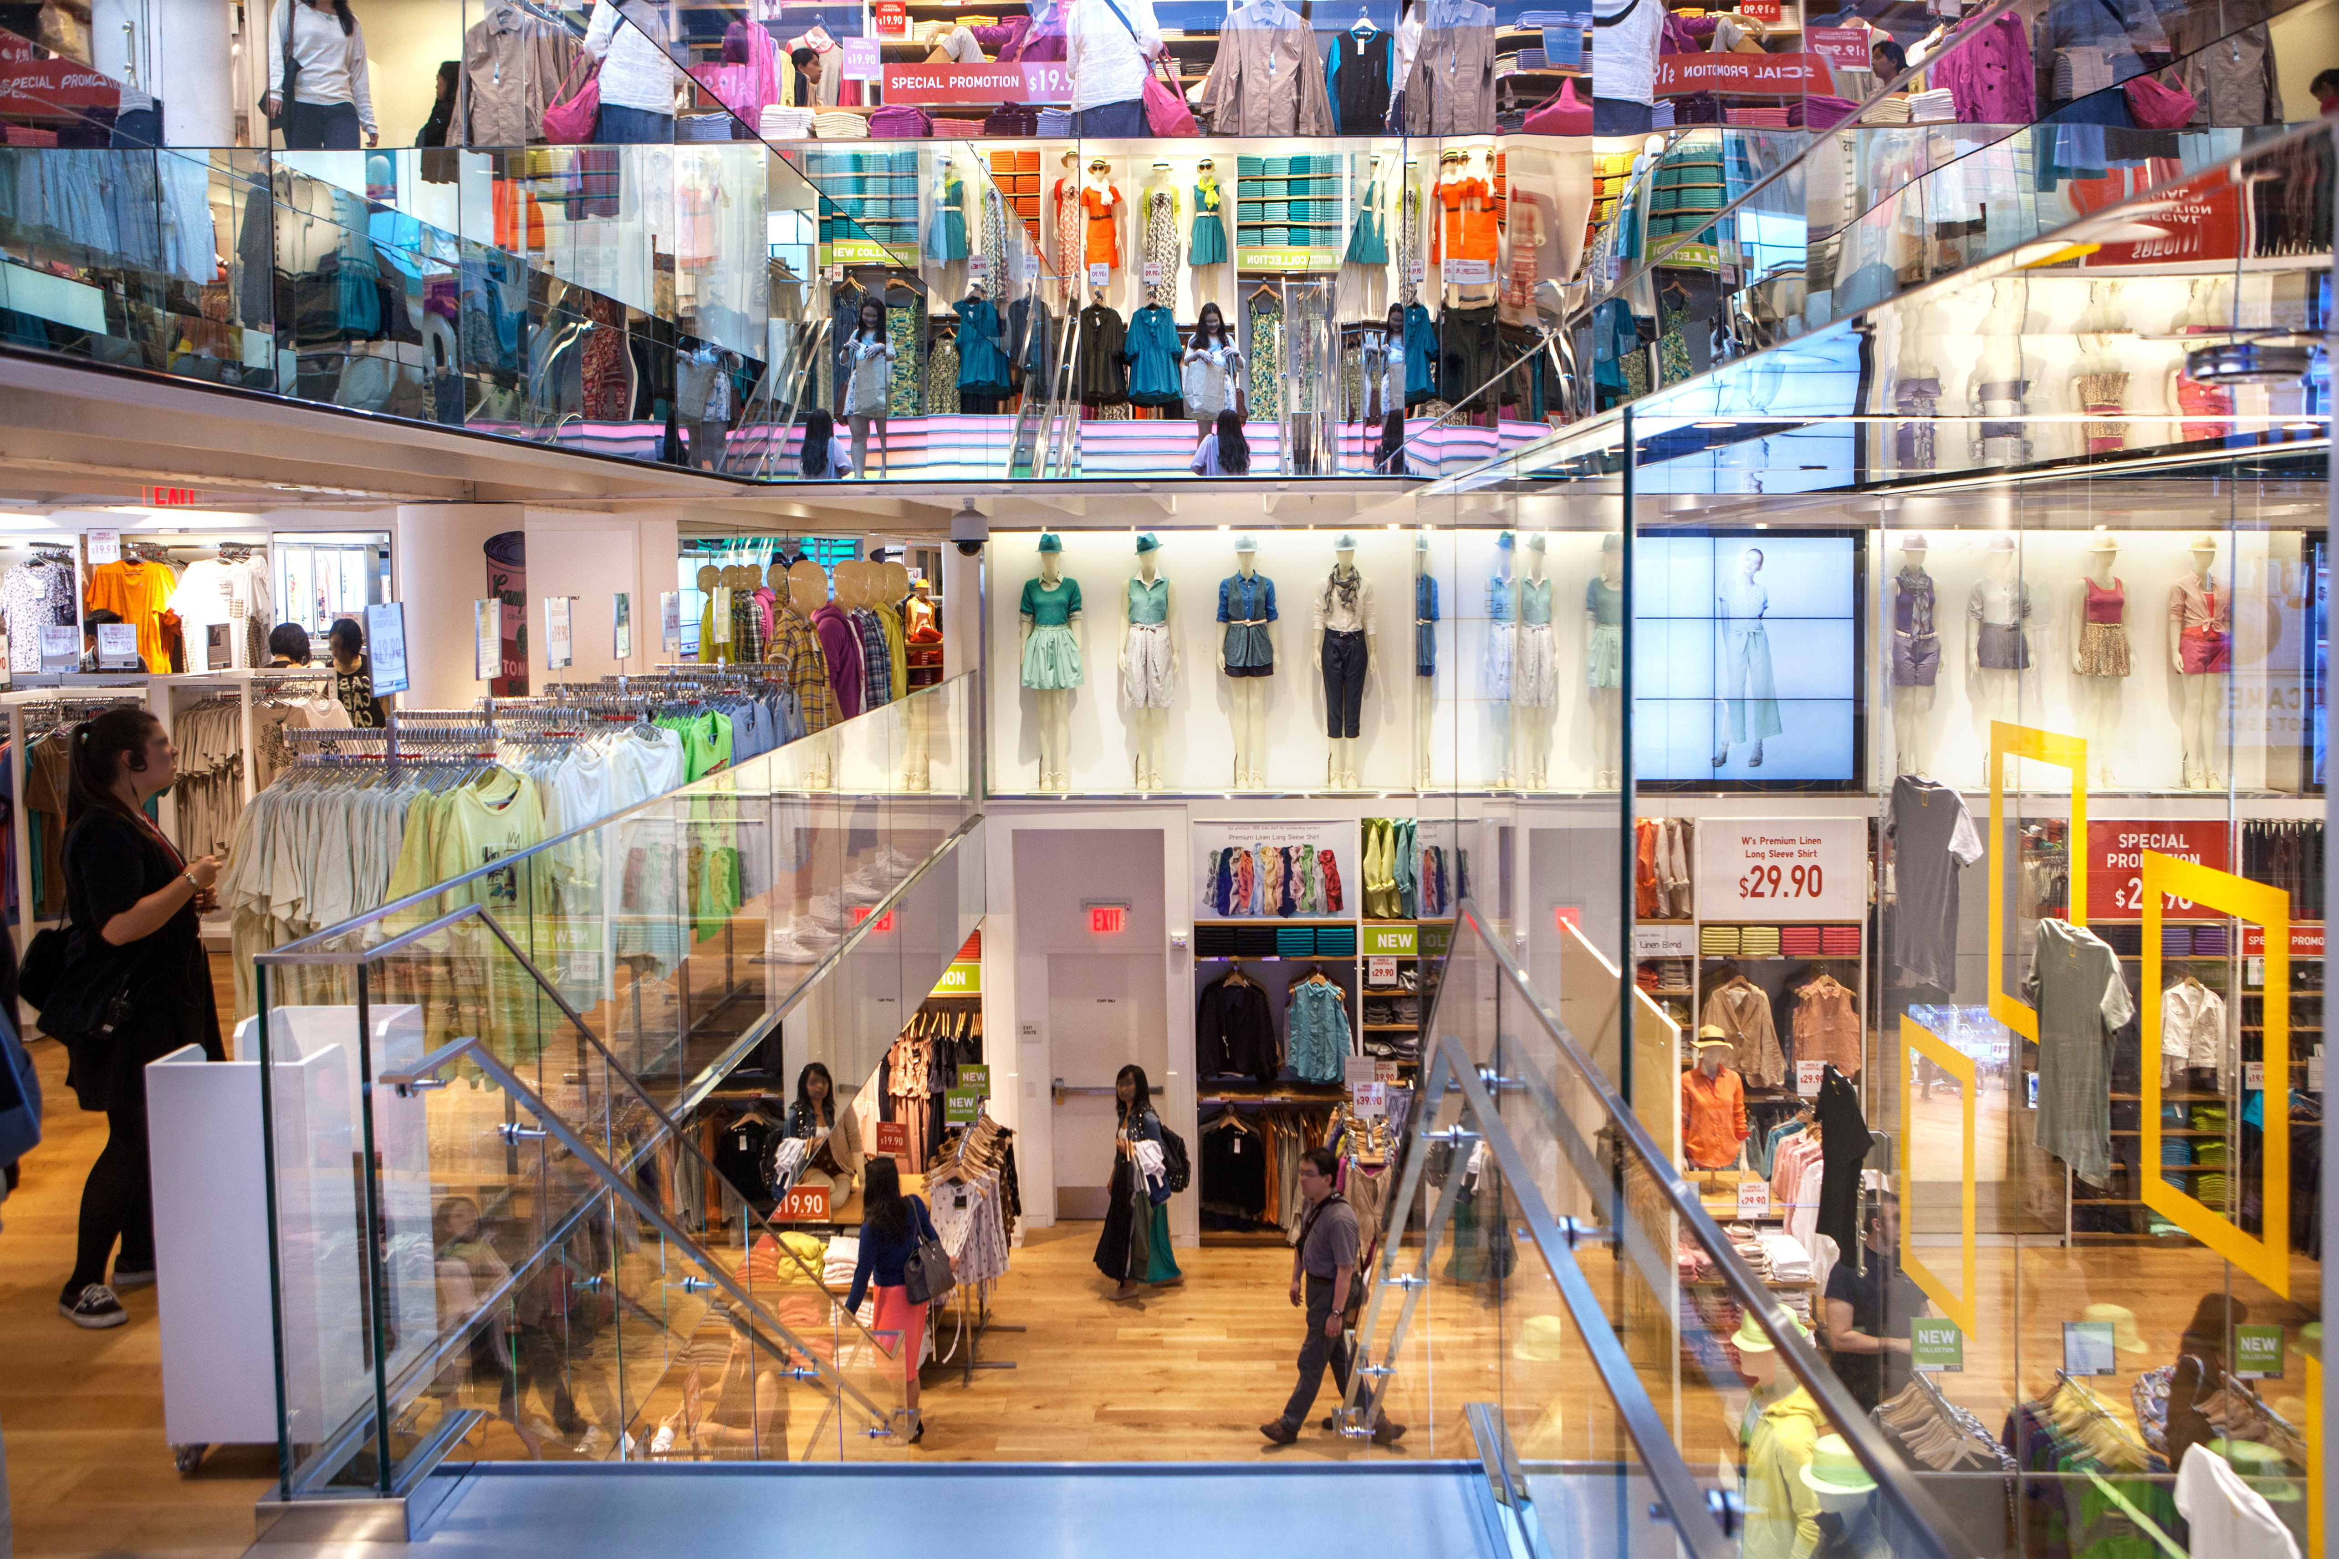

Slide 3


Slide 4


Slide 5
Why Customer 360°?

Slide 6


Slide 7
Consolidate Data

Slide 8
Understand the Customer

Slide 9


Slide 10
Why is it hard?

Slide 11
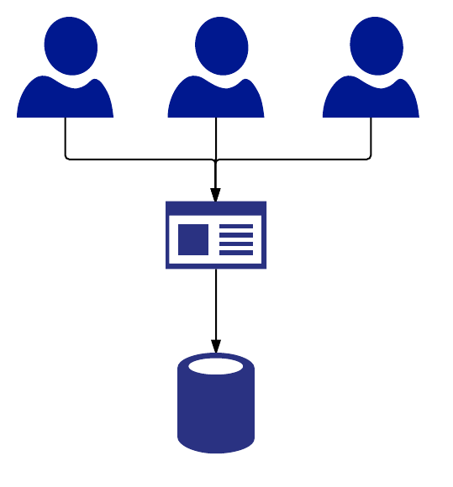

Slide 12
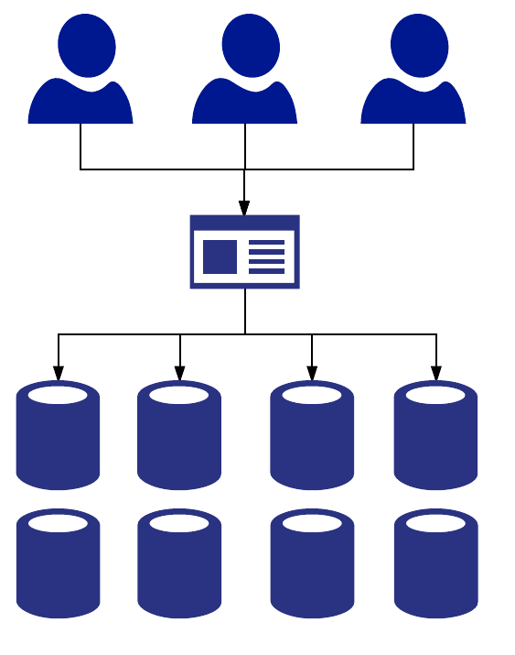

Slide 13
How do we solve it?

Slide 14



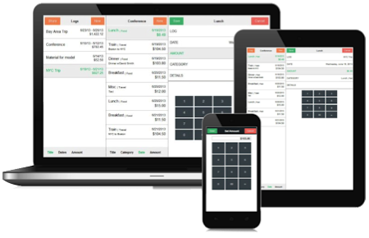
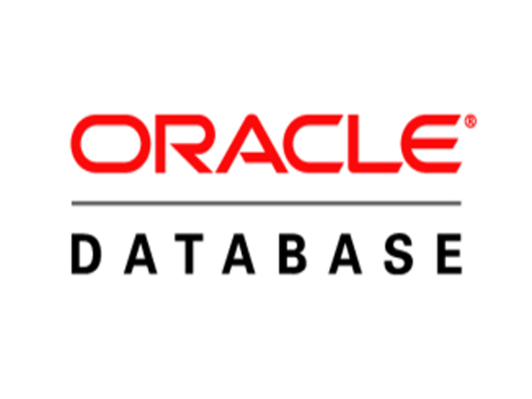
Streaming
Analytics
Batch
Analytics
Real-time
Notes:
Constrast that to our solution and you'll immediately see that we're simpler. We'll dig into this in detail, but I wanted to provide you with some context.
Challenger Commercial Teaching Step =
#6 Your Solution – our solution is unique and better than anyone else

Slide 15



Cassandra
Search
Graph
Notes:
Constrast that to our solution and you'll immediately see that we're simpler. We'll dig into this in detail, but I wanted to provide you with some context.
Challenger Commercial Teaching Step =
#6 Your Solution – our solution is unique and better than anyone else

Slide 16
Notes:
Let's dive into the use case I just mentioned, Customer 360.
To an application developer a customer is a collection of lots of different type of data. They've got orders, addresses, wish lists, connections to other users.
Graph databases make it easy to model and understand these relationships so that I can develop a full picture of my users. By creating a Customer 360, I can understand more about my user and provide them with a better experience.
You can provide better product recommendations, provide a better support experience, target them with more relevant advertisements, and gain a better picture of the total value they represent to my company.

Slide 17
